Slide 1

Math-810: MMAI
Problem-solving by search,
uninformed search, A* search and Heuristics
Instructor: Dr. Soyiba Jawed

Slide 2
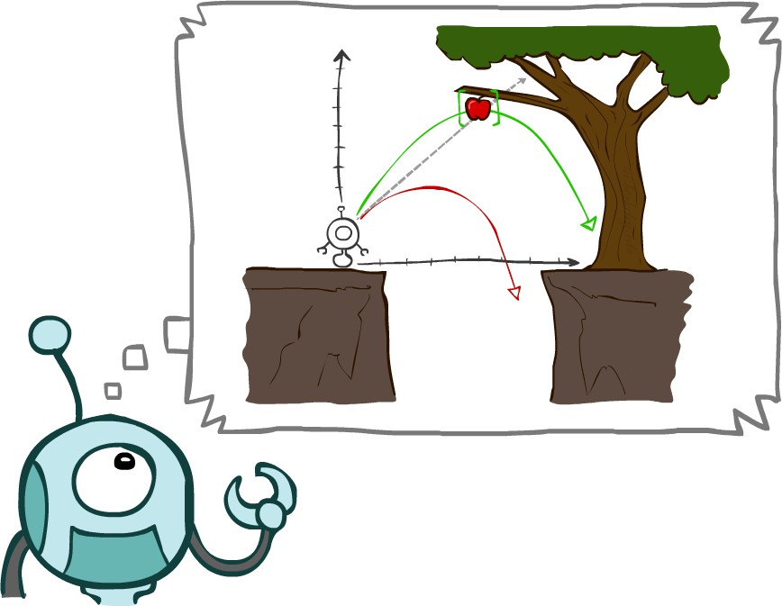
Today
Agents that Plan Ahead
Search Problems
Uninformed Search Methods
Depth-First Search
Breadth-First Search
Uniform-Cost Search

Slide 3
Agents that Plan

Slide 4
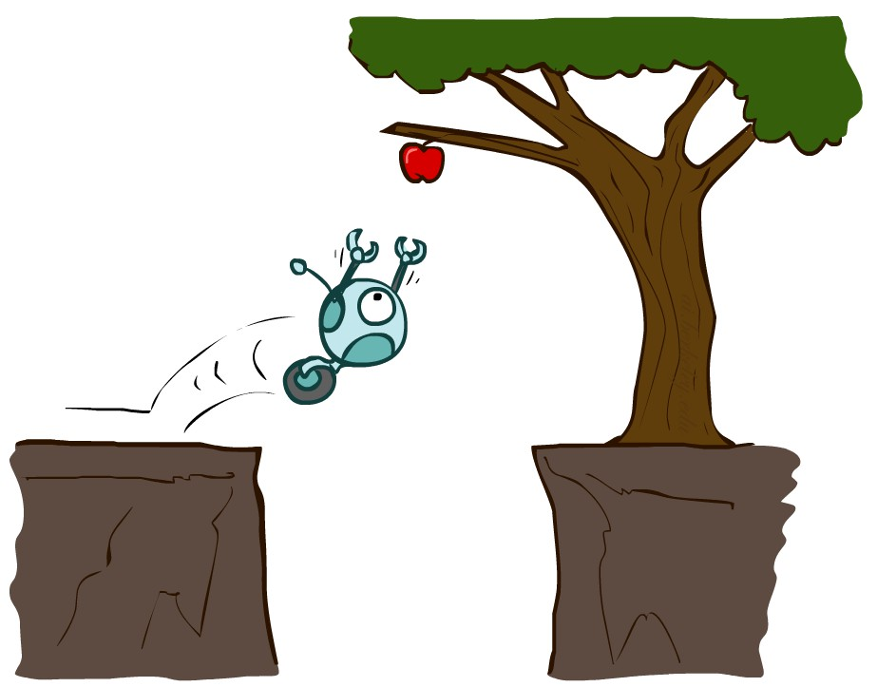
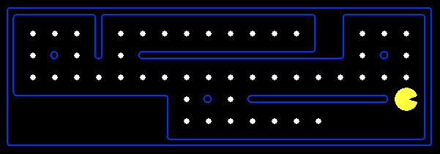
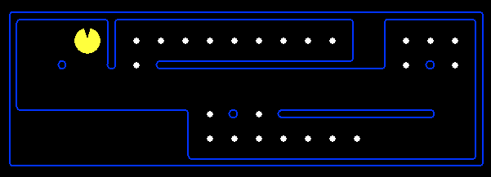
Reflex Agents
Reflex agents:
Choose action based on current percept (and maybe memory)
May have memory or a model of the world’s current state
Do not consider the future consequences of their actions
Consider how the world IS
Can a reflex agent be rational?

Slide 5
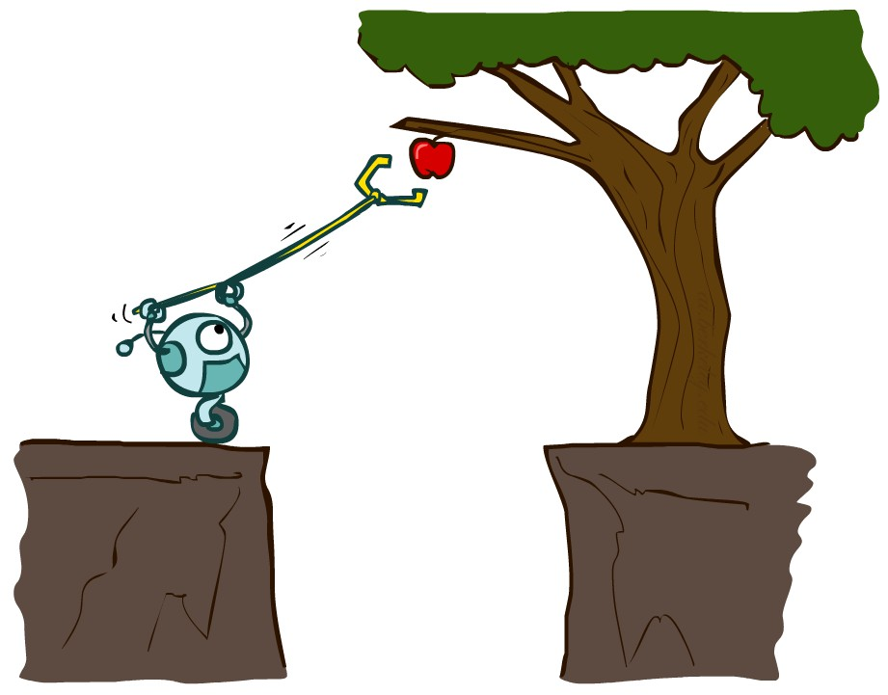
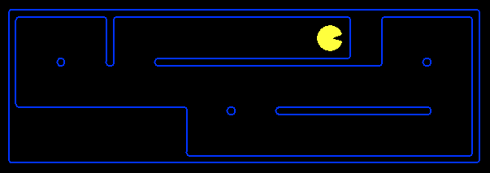
Planning Agents
Planning agents:
Ask “what if”
Decisions based on (hypothesized) consequences of actions
Must have a model of how the world evolves in response to actions
Must formulate a goal (test)
Consider how the world WOULD BE
Optimal vs. complete planning
Planning vs. replanning

Slide 6

Search Problems

Slide 7







Search Problems
A search problem consists of:
A state space
A successor function (with actions, costs)
“N”, 1.0
“E”, 1.0
A start state and a goal test
A solution is a sequence of actions (a plan) which transforms the start state to a goal state

Slide 8

Search Problems Are Models

Slide 9
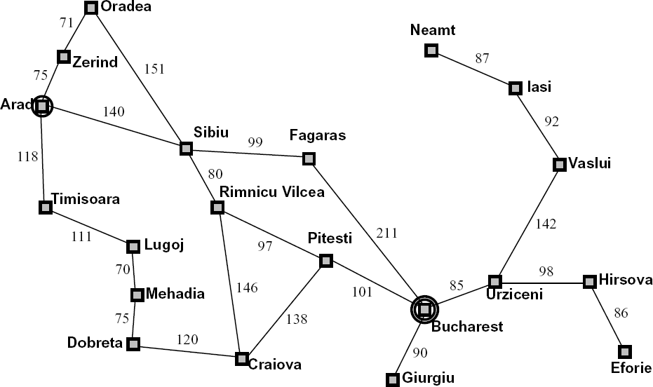
Example: Traveling in Romania
State space:
Cities
Successor function:
Roads: Go to adjacent city with cost = distance
Start state:
Arad
Goal test:
Is state == Bucharest?
Solution?

Slide 10
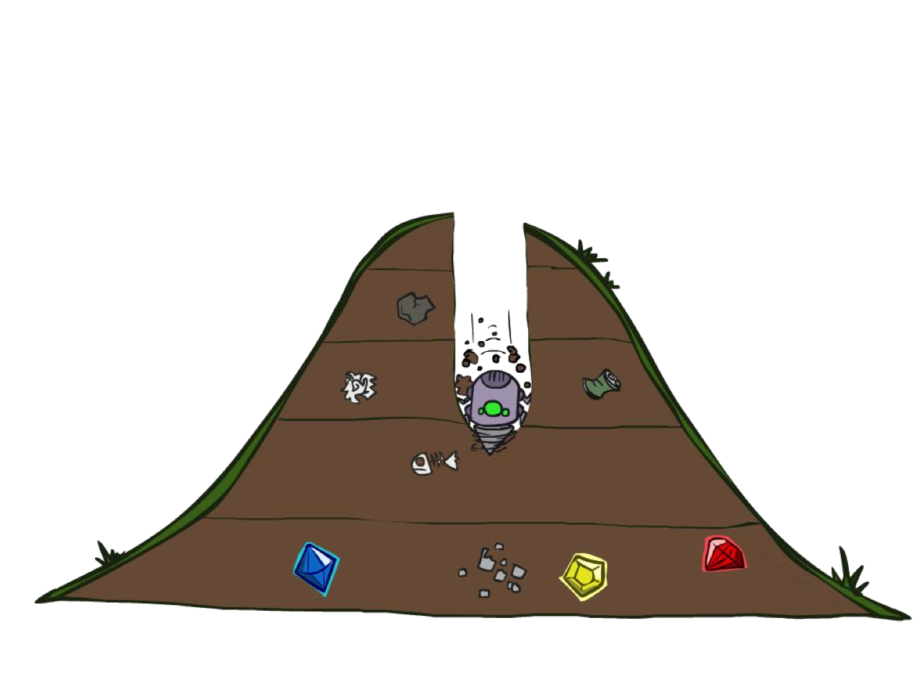
Depth-First Search

Slide 11
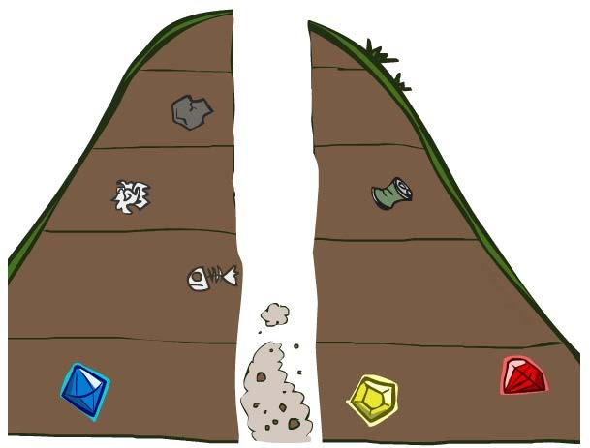
Search Algorithm Properties

Slide 12





Search Algorithm Properties
Complete: Guaranteed to find a solution if one exists?
Optimal: Guaranteed to find the least cost path?
Time complexity?
Space complexity?
1 node b nodes
b² nodes
b
…
Cartoon of search tree:
b is the branching factor
m is the maximum depth
solutions at various depths
m tiers
b^{m} nodes
Number of nodes in entire tree?
1 + b + b² + …. b^{m} = O(b^{m})

Slide 13
Depth-First Search (DFS) Properties
What nodes DFS expand?
Some left prefix of the tree.
Could process the whole tree!
If m is finite, takes time O(b^{m})
1 node b nodes
b² nodes
b
…
How much space does the fringe take?
Only has siblings on path to root, so O(bm)
Is it complete?
m could be infinite, so only if we prevent cycles (more later)
m tiers
b^{m} nodes
Is it optimal?
No, it finds the “leftmost” solution, regardless of depth or cost

Slide 14
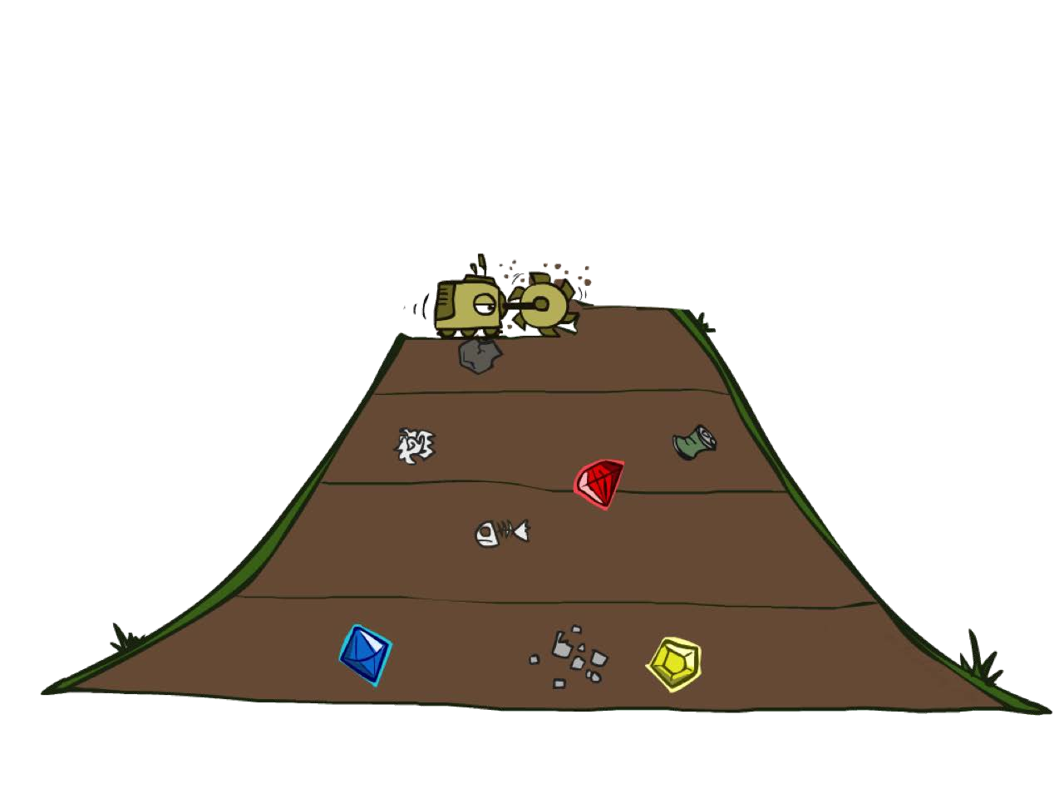
Breadth-First Search

Slide 15
Breadth-First Search
Strategy: expand a shallowest node first
Implementation: Fringe is a FIFO queue
a
G
b
c
d
e
f
S
h
p
q
r
S
d
b c e h r
e p
Search Tiers
q
a a h r p q f
p q f
q
q c
G
c
a
G
a

Slide 16


Breadth-First Search (BFS) Properties
What nodes does BFS expand?
Processes all nodes above shallowest solution
Let depth of shallowest solution be s
Search takes time O(b^{s})
1 node b nodes
b² nodes
b
…
s tiers
How much space does the fringe take?
Has roughly the last tier, so O(b^{s})
Is it complete?
s must be finite if a solution exists, so yes!
Is it optimal?
Only if costs are all 1 (more on costs later)
b^{s} nodes
b^{m} nodes

Slide 17
Uniform Cost Search
2
a
G
Strategy: expand a cheapest node first:
b
c
1
8
2
2
e
_{h} 8
3
d
f
Fringe is a priority queue (priority: cumulative cost)
9
2
S
1
1
p
q
r
15
S 0
e
d
3
9
p
1
b
4
^{c} 11
a
e
5
h 17
r
11
q
16
Cost contours
a
6
h
13
r
7
p q f
p q f
8
q
c
a
G
q
11
c
a
G 10

Slide 18




Uniform Cost Search (UCS) Properties
What nodes does UCS expand?
Processes all nodes with cost less than cheapest solution!
If that solution costs C* and arcs cost at least ε , then the “effective depth” is roughly C*/ε
Takes time O(b^{C*/ε}) (exponential in effective depth)
How much space does the fringe take?
Has roughly the last tier, so O(b^{C*/ε})
b
c ≤ 1
c ≤ 2
c ≤ 3
…
C*/ε “tiers”
Is it complete?
Assuming best solution has a finite cost and minimum arc cost is positive, yes!
Is it optimal?
Yes! (Proof next lecture via A*)

Slide 19







Uniform Cost Issues
Remember: UCS explores increasing cost contours
…
c ≤ 1
c ≤ 2
c ≤ 3
The good: UCS is complete and optimal!
The bad:
Explores options in every “direction”
No information about goal location
Start
Goal
We’ll fix that soon!

Slide 20

The One Queue
All these search algorithms are the same except for fringe strategies
Conceptually, all fringes are priority queues (i.e. collections of nodes with attached priorities)
Practically, for DFS and BFS, you can avoid the log(n) overhead from an actual priority queue, by using stacks and queues
Can even code one implementation that takes a variable queuing object

Slide 21
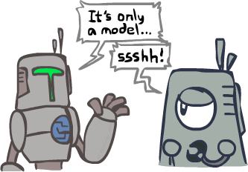
Search and Models
Search operates over models of the world
The agent doesn’t actually try all the plans out in the real world!
Planning is all “in simulation”
Your search is only as good as your models…

Slide 22
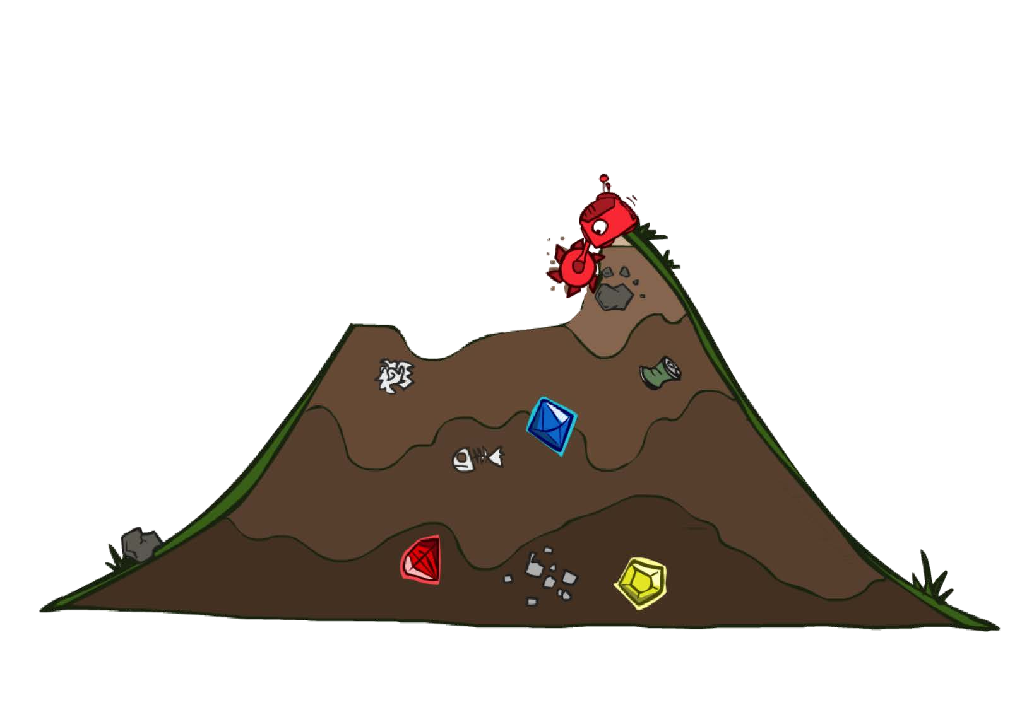
Uninformed Search

Slide 23



Uniform Cost Search
Strategy: expand lowest path cost
c ≤ 1
c ≤ 2
c ≤ 3
…
The good: UCS is complete and optimal!
The bad:
Explores options in every “direction”
No information about goal location
Start
Goal

Slide 24

Informed Search

Slide 25
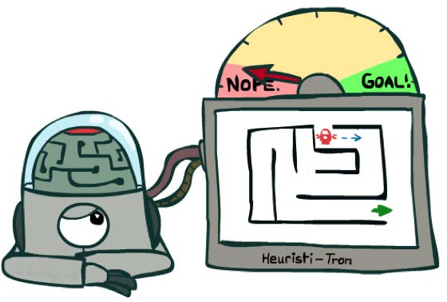
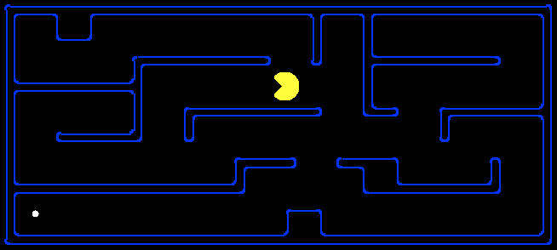
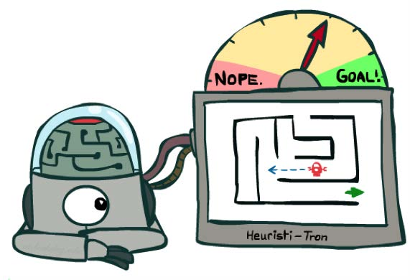
Search Heuristics
A heuristic is:
A function that estimates how close a state is to a goal
Designed for a particular search problem
Examples: Manhattan distance, Euclidean distance for pathing
10
5
11.2

Slide 26
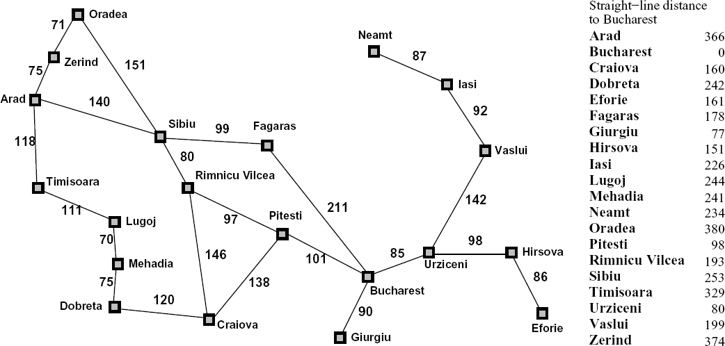
Example: Heuristic Function
h(x)

Slide 27
Example: Heuristic Function
Heuristic: the number of the largest pancake that is still out of place
3
h(x)
4
3
4
3
0
4
4
3
4
4
2
3

Slide 28
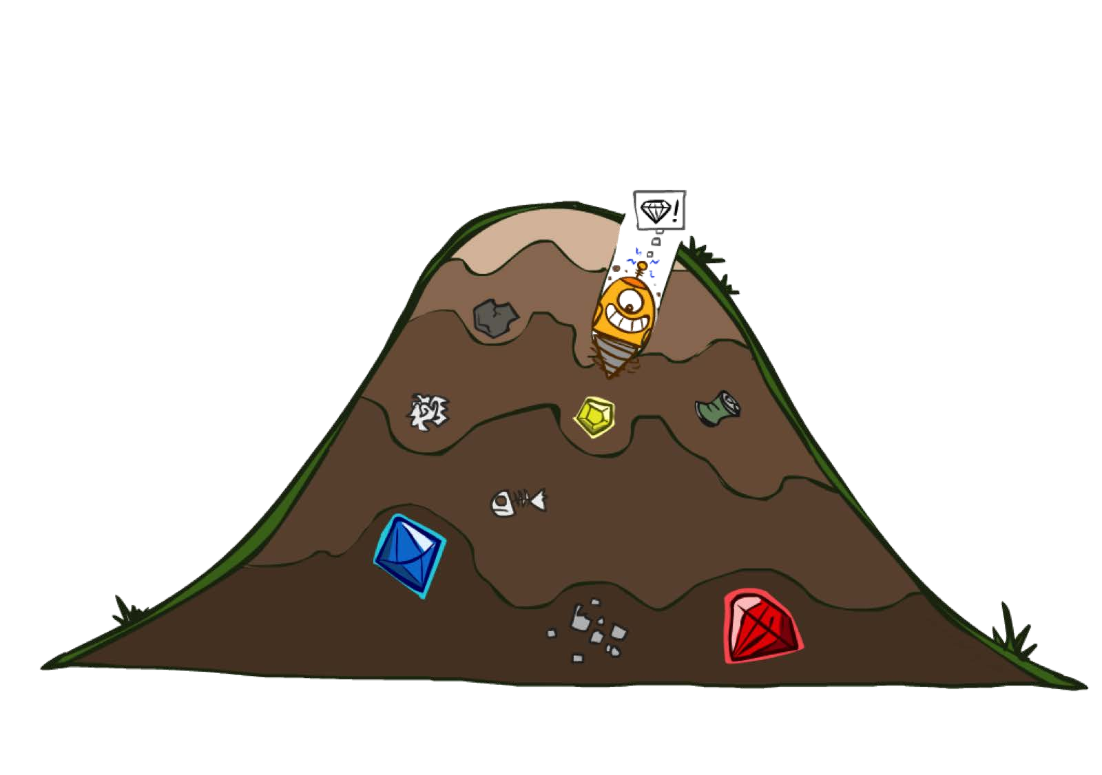
Greedy Search

Slide 29
Example: Heuristic Function
h(x)

Slide 30
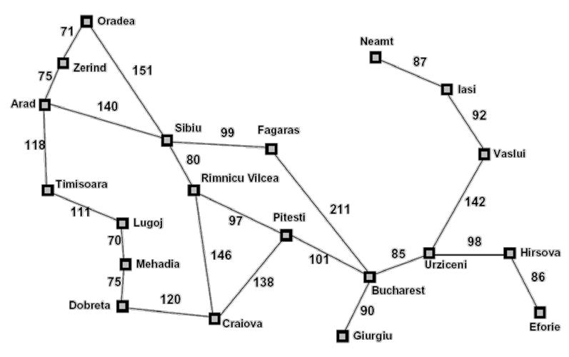
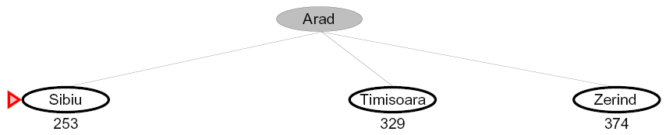
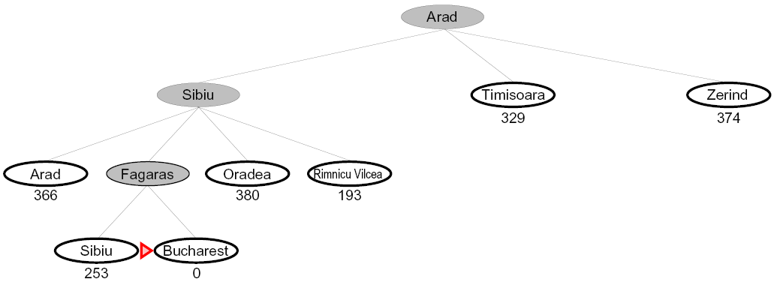

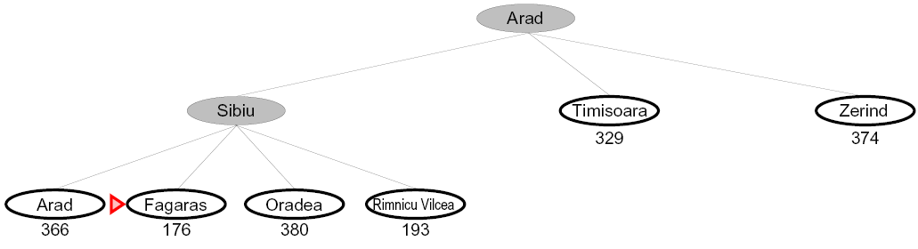

Greedy Search
Expand the node that seems closest…
What can go wrong?

Slide 31


Greedy Search
b
Strategy: expand a node that you think is closest to a goal state
Heuristic: estimate of distance to nearest goal for each state
…
A common case:
Best-first takes you straight to the (wrong) goal
b
…
Worst-case: like a badly-guided DFS

Slide 32

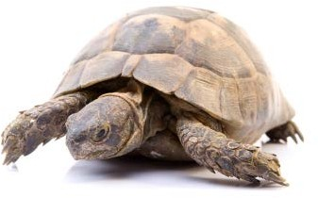

A* Search
UCS Greedy
A*

Slide 33
Combining UCS and Greedy
Uniform-cost orders by path cost, or backward cost g(n)
Greedy orders by goal proximity, or forward cost h(n)
8
g = 0 h=6
S
e
h=1
g = 1 h=5
a
1
1
3
2
g = 2 h=6
g = 9 h=1
S
a
d
G
b
d
g = 4 h=2
e
h=6
1
h=5
h=2
h=0
c
h=7
1
b
h=6
g = 3 h=7
g = 6 h=0
g = 10
h=2
c
G
d
g = 12
h=0
G
A* Search orders by the sum: f(n) = g(n) + h(n)
Example: Teg Grenager

Slide 34
When should A* terminate?
Should we stop when we enqueue a goal?
h = 2
2
A
2
S
h = 3
h = 0
G
2
B
h = 1
3
No: only stop when we dequeue a goal

Slide 35
Is A* Optimal?
h = 6
1
A
3
S
h = 7
G
h = 0
5
What went wrong?
Actual bad goal cost < estimated good goal cost
We need estimates to be less than actual costs!

Slide 36
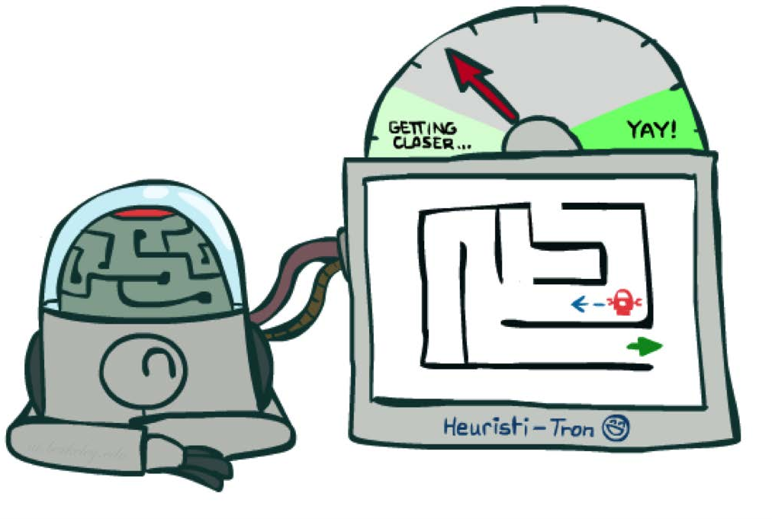
Admissible Heuristics

Slide 37
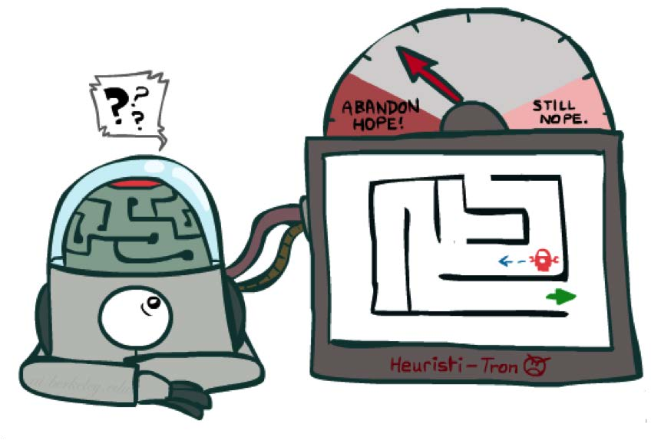
Idea: Admissibility
Inadmissible (pessimistic) heuristics break optimality by trapping good plans on the fringe
Admissible (optimistic) heuristics slow down bad plans but never outweigh true costs

Slide 38


Admissible Heuristics
A heuristic h is admissible (optimistic) if:
where
is the true cost to a nearest goal
Examples:
4
15
Coming up with admissible heuristics is most of what’s involved in using A* in practice.

Slide 39

Optimality of A* Tree Search

Slide 40





Optimality of A* Tree Search
Assume:
A is an optimal goal node
B is a suboptimal goal node
h is admissible
…
Claim:
A will exit the fringe before B

Slide 41




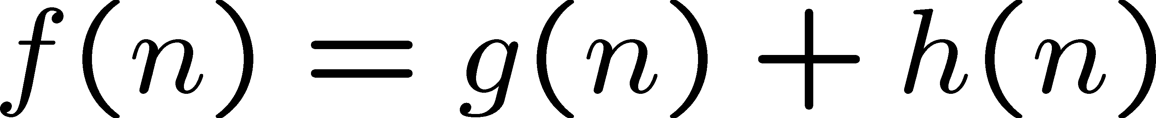
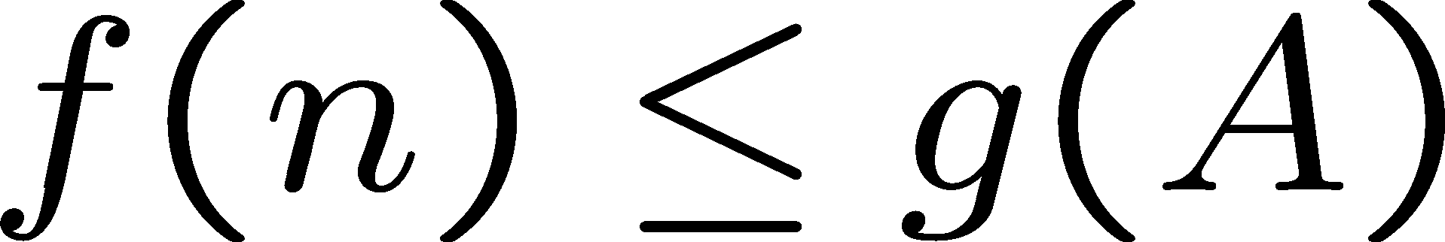
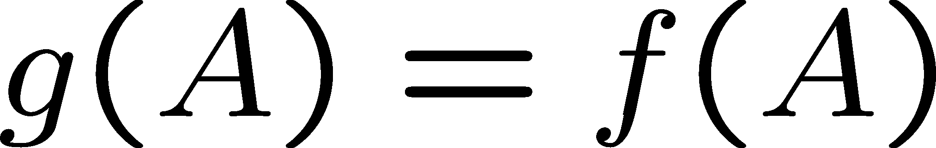
Optimality of A* Tree Search: Blocking
Proof:
Imagine B is on the fringe
Some ancestor n of A is on the fringe, too (maybe A!)
Claim: n will be expanded before B
f(n) is less or equal to f(A)
…
Definition of f-cost Admissibility of h h = 0 at a goal

Slide 42
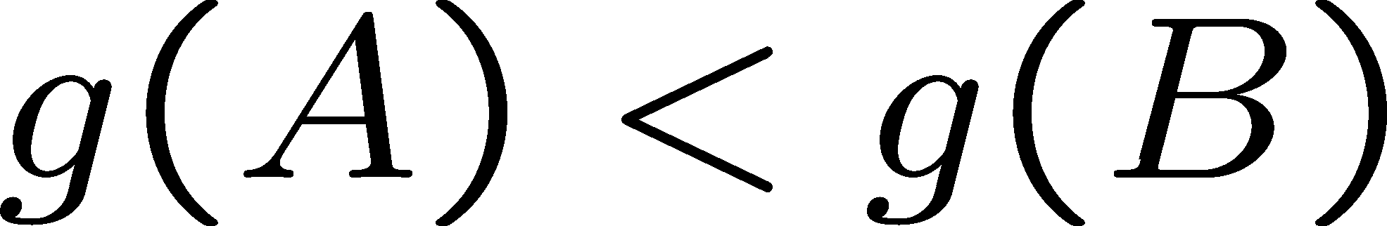
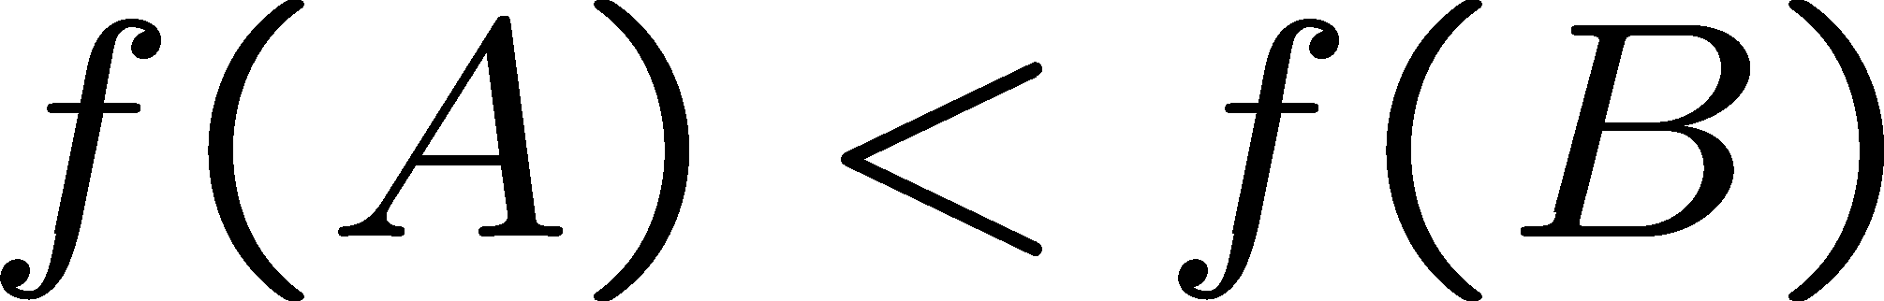
Optimality of A* Tree Search: Blocking
Proof:
Imagine B is on the fringe
Some ancestor n of A is on the fringe, too (maybe A!)
Claim: n will be expanded before B
…
f(n) is less or equal to f(A)
f(A) is less than f(B)
B is suboptimal h = 0 at a goal

Slide 43

Optimality of A* Tree Search: Blocking
Proof:
Imagine B is on the fringe
Some ancestor n of A is on the fringe, too (maybe A!)
Claim: n will be expanded before B
…
f(n) is less or equal to f(A)
f(A) is less than f(B)
n expands before B
All ancestors of A expand before B
A expands before B
A* search is optimal

Slide 44
Properties of A*

Slide 45

Properties of A*
Uniform-Cost
A*
b
b
…
…

Slide 46


UCS vs A* Contours
Uniform-cost expands equally in all “directions”
Start
Goal
A* expands mainly toward the goal, but does hedge its bets to ensure optimality
Start
Goal

Slide 47
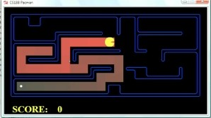
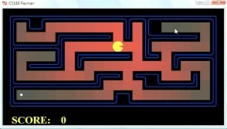
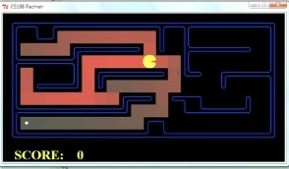
Comparison
Greedy
Uniform Cost
A*

Slide 48
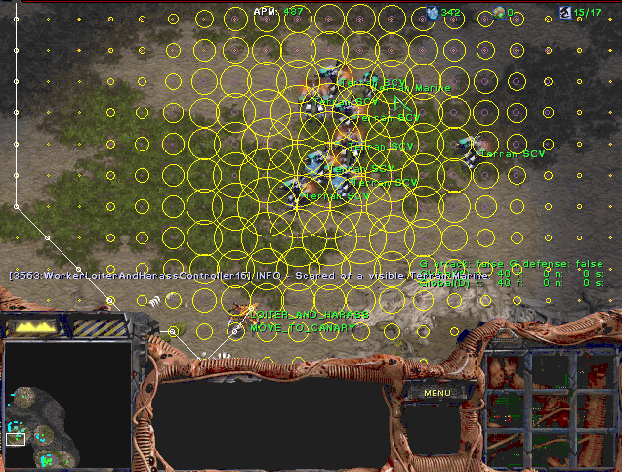
A* Applications

Slide 49
A* Applications
Video games
Pathing / routing problems
Resource planning problems
Robot motion planning
Language analysis
…

Slide 50

Creating Heuristics

Slide 51
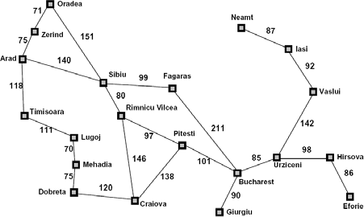
Creating Admissible Heuristics
Most of the work in solving hard search problems optimally is in coming up with admissible heuristics
Often, admissible heuristics are solutions to relaxed problems, where new actions are available
366
15
Inadmissible heuristics are often useful too

Slide 52
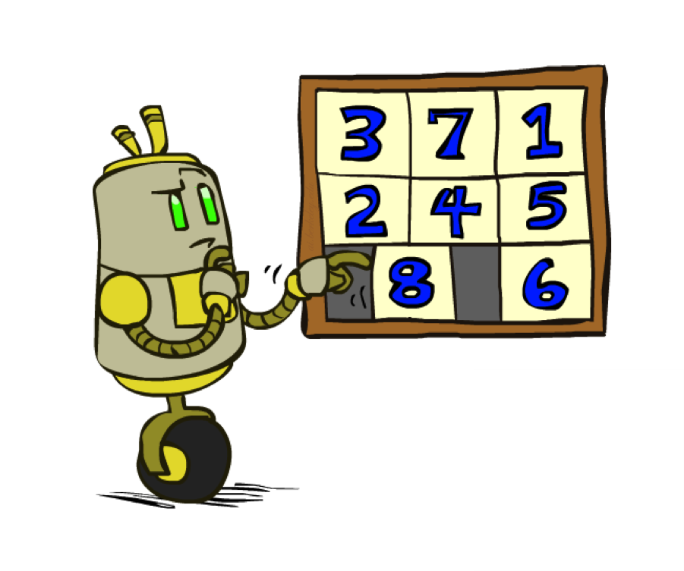
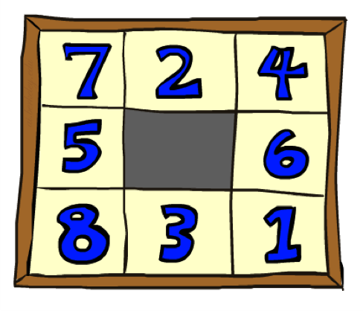
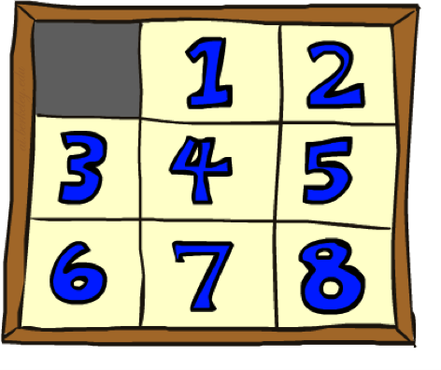
Example: 8 Puzzle
Start State Actions
What are the states?
How many states?
What are the actions?
How many successors from the start state?
What should the costs be?
Goal State

Slide 53
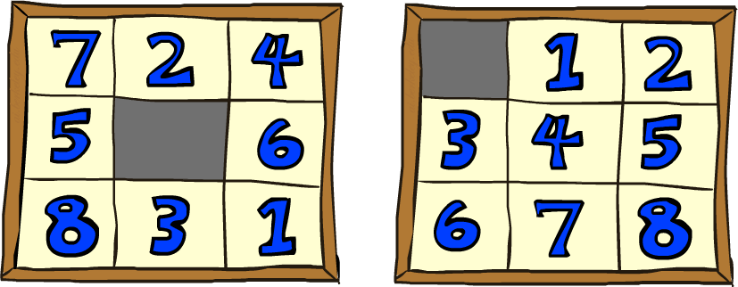
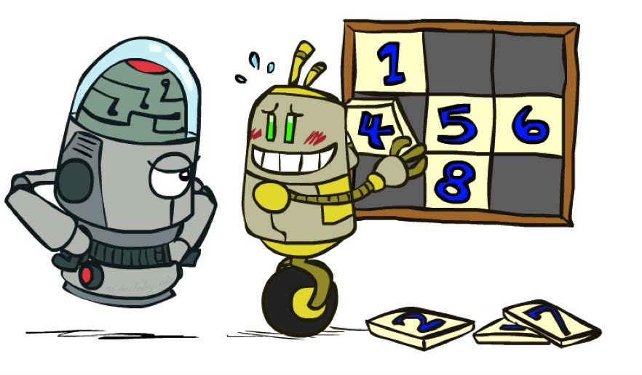
8 Puzzle I
Heuristic: Number of tiles misplaced
Why is it admissible?
h(start) = 8
This is a relaxed-problem heuristic
Start State
Goal State
 | Average nodes expanded when the optimal path has…
 | …4 steps | …8 steps | …12 steps
UCS | 112 | 6,300 | 3.6 x 10⁶
TILES | 13 | 39 | 227
Statistics from Andrew Moore

Slide 54
8 Puzzle II
What if we had an easier 8-puzzle where any tile could slide any direction at any time, ignoring other tiles?
Total Manhattan distance
Start State
Goal State
Why is it admissible?
h(start) = 3 + 1 + 2 + … = 18
 | Average nodes expanded when the optimal path has…
 | …4 steps | …8 steps | …12 steps
TILES | 13 | 39 | 227
MANHATTAN | 12 | 25 | 73
▪

Slide 55
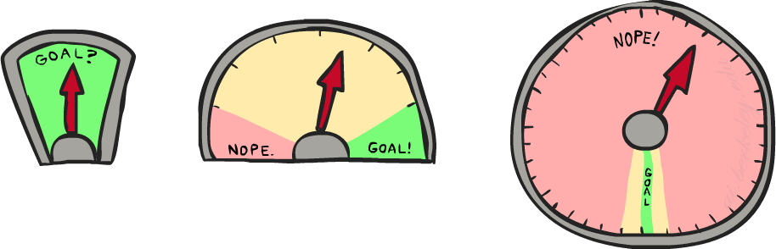
8 Puzzle III
How about using the actual cost as a heuristic?
Would it be admissible?
Would we save on nodes expanded?
What’s wrong with it?
With A*: a trade-off between quality of estimate and work per node
As heuristics get closer to the true cost, you will expand fewer nodes but usually do more work per node to compute the heuristic itself

Slide 56
Semi-Lattice of Heuristics

Slide 57







Trivial Heuristics, Dominance
Dominance: h_{a} ≥ h_{c} if
Heuristics form a semi-lattice:
Max of admissible heuristics is admissible
Trivial heuristics
Bottom of lattice is the zero heuristic (what does this give us?)
Top of lattice is the exact heuristic

Slide 58
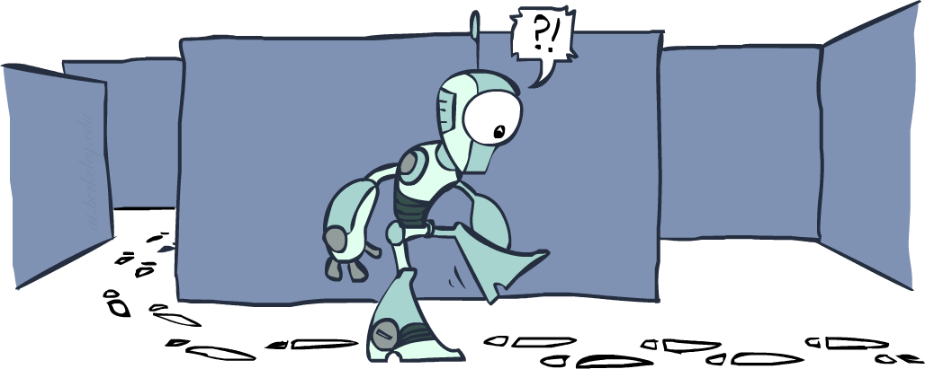
Graph Search

Slide 59
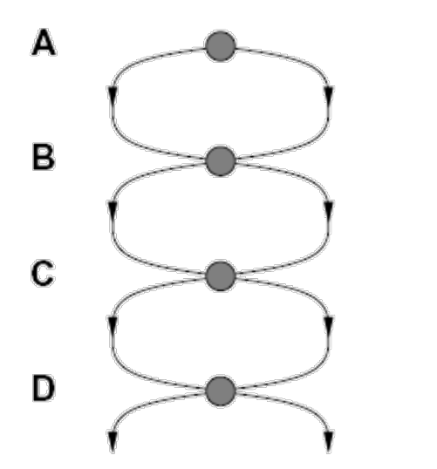
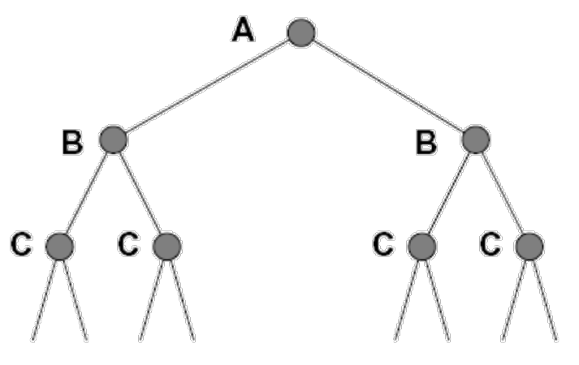
Tree Search: Extra Work!
Failure to detect repeated states can cause exponentially more work.
State Graph
Search Tree

Slide 60
Graph Search
In BFS, for example, we shouldn’t bother expanding the circled nodes (why?)
S
d
e
p
b
c
e
h
r
q
a
a
h
r
p q f
p q f
q
c
G
q
c
G
a
a

Slide 61
Graph Search
Idea: never expand a state twice
How to implement:
Tree search + set of expanded states (“closed set”)
Expand the search tree node-by-node, but…
Before expanding a node, check to make sure its state has never been expanded before
If not new, skip it, if new add to closed set
Important: store the closed set as a set, not a list
Can graph search wreck completeness? Why/why not?
How about optimality?

Slide 62
A* Graph Search Gone Wrong?
State space graph
Search tree
A
S (0+2)
1
1
S
h=4
C
h=1
A (1+4)
B (1+1)
h=2
1
2
3
C (2+1)
C (3+1)
B
h=1
G (5+0)
G (6+0)
G
h=0

Slide 63
Consistency of Heuristics
Main idea: estimated heuristic costs ≤ actual costs
Admissibility: heuristic cost ≤ actual cost to goal
A
1
h(A) ≤ actual cost from A to G
h=4 h=2
C
h=1
Consistency: heuristic “arc” cost ≤ actual cost for each arc
h(A) – h(C) ≤ cost(A to C)
3
Consequences of consistency:
The f value along a path never decreases
G
h(A) ≤ cost(A to C) + h(C)
A* graph search is optimal

Slide 64
Optimality of A* Graph Search

Slide 65


Optimality of A* Graph Search
Sketch: consider what A* does with a consistent heuristic:
f ≤ 1
f ≤ 2
f ≤ 3
Fact 1: In tree search, A* expands nodes in increasing total f value (f-contours)
…
Fact 2: For every state s, nodes that reach s optimally are expanded before nodes that reach s suboptimally
Result: A* graph search is optimal

Slide 66
Optimality
Tree search:
A* is optimal if heuristic is admissible
UCS is a special case (h = 0)
Graph search:
A* optimal if heuristic is consistent
UCS optimal (h = 0 is consistent)
Consistency implies admissibility
In general, most natural admissible heuristics tend to be consistent, especially if from relaxed problems

Slide 67

A*: Summary

Slide 68

A*: Summary
A* uses both backward costs and (estimates of) forward costs
A* is optimal with admissible / consistent heuristics
Heuristic design is key: often use relaxed problems

Slide 69
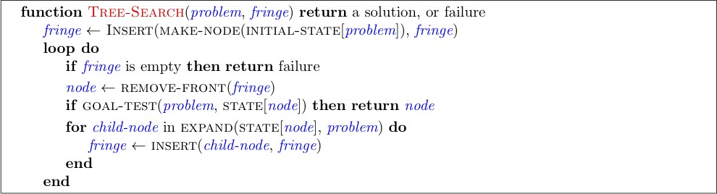
Tree Search Pseudo-Code

Slide 70
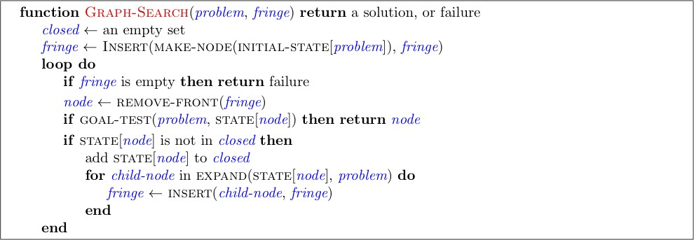
Graph Search Pseudo-Code

Slide 71
Optimality of A* Graph Search
Consider what A* does:
Expands nodes in increasing total f value (f-contours) Reminder: f(n) = g(n) + h(n) = cost to n + heuristic
Proof idea: the optimal goal(s) have the lowest f value, so it must get expanded first
f ≤ 1
f ≤ 2
f ≤ 3
…
There’s a problem with this argument. What are we assuming is true?

Slide 72




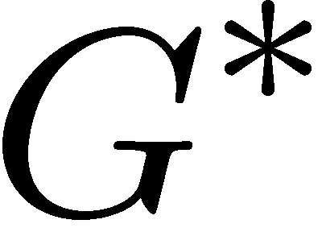

Optimality of A* Graph Search
Proof:
New possible problem: some n on path to G* isn’t in queue when we need it, because some worse n’ for the same state dequeued and expanded first (disaster!)
Take the highest such n in tree
Let p be the ancestor of n that was on the queue when n’ was popped
f(p) < f(n) because of consistency
f(n) < f(n’) because n’ is suboptimal
p would have been expanded before n’
Contradiction!

